Slide 1
QUALITATIVE DATA ANALYSIS
NERA Webinar Presentation
Felice D. Billups, Ed.D.

Slide 2

GETTING STARTED?
Have you just conducted a qualitative study involving…
Interviews
Focus Groups
Observations
Document or artifact analysis
Journal notes or reflections?

Slide 3

WHAT TO DO WITH ALL THIS DATA?
Just as there are numerous statistical tests to run for quantitative data, there are just as many options for qualitative data analysis…

Slide 4
OVERVIEW
This session is designed to provide a step-by-step guide for beginning qualitative researchers…who want to know how to apply the appropriate strategies for data analysis, interpretation, and reporting.

Slide 5

LIKE CLEANING A CLOSET ???
Think of managing your qualitative analysis process like cleaning your closets – the same basic steps apply!

Slide 6

It’s the same process…
1. Take everything out of the closet
2. Sort everything out – save or toss?
3. Look at what you have left and organize into sub-groupings (chunking)
4. Organize sub-groups into clusters of similar things that belong together (clusters, codes)
5. As you put things back, how would you group them to maximize functionality? How do the groups make it work together? (interpretation, presentation)

Slide 7
FOUR BASIC STEPS
All qualitative data analysis involves the same four essential steps:
1. Raw data management- ‘data cleaning’
2. Data reduction, I, II – ‘chunking’, ‘coding’
3. Data interpretation – ‘coding’, ‘clustering’
4. Data representation – ‘telling the story’,
‘making sense of the data for others’

Slide 8
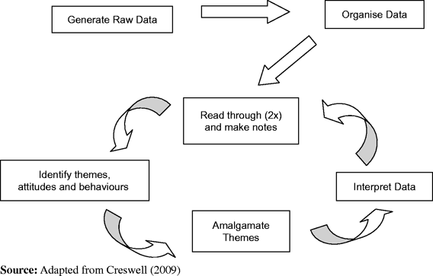
DATA ANALYSIS SPIRAL #1

Slide 9
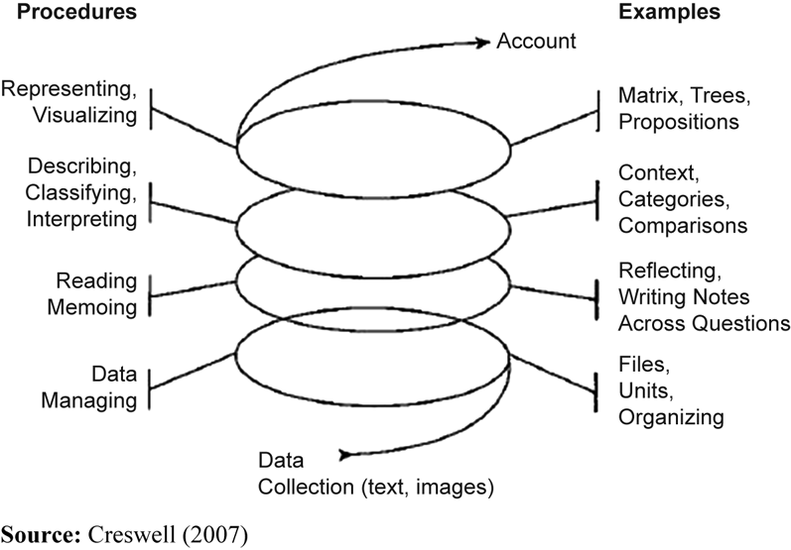
DATA ANALYSIS SPIRAL #2

Slide 10

Step 1: Raw Data Management
What is raw data management?
  The process of preparing and organizing raw data into meaningful units of analysis:
    Text or audio data transformed into transcripts
    Image data transformed into videos, photos, charts
    As you review your data, you find that some of it is not usable or relevant to your study…

Slide 11
Raw Data Sample
I always wanted to get my doctorate but I never felt I had the time; then I reached a point in my career where I saw that without the credentials, I would never advance to the types of positions I aspired to..but I doubted I could do the work. I wasn’t sure I could go back to school after so much time. And did I have the time, with working and a family? These were the things I struggled with as I looked for the right program.
Um, ..finally starting the program with others like me, it felt surreal. Once you switch gears from being an established administrator at a college to being a doc student, you realize you lose control over your life. You are not in charge in that classroom, like you are in your office. But also, once you say you are a doc student, people look at you differently. And people at work began to take me more seriously, ask for my opinion as if I now possessed special knowledge because I was going for the doctorate. It was the same information I had shared previously but somehow it had a special quality? Its like magic!
I can’t think of a particular example right now…
Are some portions of this transcript unusable or irrelevant? (purple)
Transcript of Interview Data
Raw Data Overview

Slide 12
Step II: Data Reduction I
Get a sense of the data holistically, read several times (immersion)
Classify and categorize repeatedly, allowing for deeper immersion
Write notes in the margins (memoing)
Preliminary classification schemes emerge, categorize raw data into groupings (chunking)

Slide 13
Winnowing
Develop an initial sense of usable data and the general categories you will create
Preliminary set of codes developed, cluster raw data into units that share similar meanings or qualities
Create initial code list or master code book

Slide 14
Chunks-Clusters Sample
I always wanted to get my doctorate but I never felt I had the time; then I reached a point in my career where I saw that without the credentials, I would never advance to the types of positions I aspired to..but I doubted I could do the work. I wasn’t sure I could go back to school after so much time. And did I have the time, with working and a family? These were the things I struggled with as I looked for the right program.
-finally starting the program with others like me, it felt surreal. Once you switch gears from being an established administrator at a college to being a doc student, you realize you lose control over your life. You are not in charge in that classroom, like you are in your office. But also, once you say you are a doc student, people look at you differently. And people at work began to take me more seriously, ask for my opinion as if I now possessed special knowledge because I was going for the doctorate. It was the same information I had shared previously but somehow it had a special quality? Its like magic!
Which sections of data are broadly similar? (red for credentials, blue for personal struggles, green for shift in identity)
Which ‘chunks’ can be clustered together to relate to a broad coding scheme?
Transcript of Interview Data
Chunking? Clusters?

Slide 15
Step II: Data Reduction II
  The process of reducing data from chunks into clusters and codes to make meaning of that data:
    Chunks of data that are similar begin to lead to initial clusters and coding
      Clusters – assigning chunks of similarly labeled data into clusters and assigning preliminary codes
      Codes – refining, developing code books, labeling codes, creating codes through 2-3 cycles

Slide 16
Coding Process
Initial coding may include as many as 30 categories
Reduce codes once, probably twice
Reduce again to and refine to codes that are mutually exclusive and include all raw data that was identified as usable

Slide 17
A Priori or In Vivo Codes
A Priori
  Codes derived from literature, theoretical frames
In Vivo (inductive or grounded)
  Codes derived from the data by using code names drawn from participant quotes or interpretation of the data
    “Its like magic” is a phrase that could form the basis for a code category

Slide 18
Coding Levels
Descriptive to Interpretative to Pattern Coding
  Moves from summary to meaning to explanation
OR
Open to Axial to Selective Coding
  Moves from initial theory to developing relationships between codes for emerging theory
OR
First cycle to second cycle coding
  Moving from describing the data units to inferring meaning

Slide 19
Coding Sample
I always wanted to get my doctorate but I never felt I had the time; then I reached a point in my career where I saw that without the credentials, I would never advance to the types of positions I aspired to..but I doubted I could do the work. I wasn’t sure I could go back to school after so much time. And did I have the time, with working and a family? These were the things I struggled with as I looked for the right program.
-finally starting the program with others like me, it felt surreal. Once you switch gears from being an established administrator at a college to being a doc student, you realize you lose control over your life. You are not in charge in that classroom, like you are in your office. But also, once you say you are a doc student, people look at you differently. And people at work began to take me more seriously, ask for my opinion as if I now possessed special knowledge because I was going for the doctorate. It was the same information I had shared previously but somehow it had a special quality? Its like magic!
Chunking to coding:
Red for credentials – codes include career goals CG, career advancement CA
Blue for personal struggles- codes include self-doubt SD, time management TM
Green for shift in identity – codes include student role SR, identity at work IW, shift in control SC
Transcript of Interview Data
Chunking? Clusters? Coding?

Slide 20
Coding Levels (revisiting)
Descriptive to Interpretative to Pattern Coding
  Moves from summary to meaning to explanation
OR
Open to Axial to Selective Coding
  Moves from initial theory to developing relationships between codes for emerging theory
OR
First cycle to second cycle coding
  Moving from describing the data units to inferring meaning

Slide 21
Coding Progression
Descriptive Interpretative
Credentials CG,CA
                need for career
                advancement, goals
Personal PSD,PG,PWL
              Self-doubt
              Personal growth
              Work-life balance
Identity IS, ISR, ISC
                identity shifting
                student role
                shift in control
Pattern
CR – needing a doctorate to advance professionally and to meet personal goals for achievement
PG – personal struggles evolve to address self-doubt about abilities, trying to achieve things before time runs out, balancing responsibilities with family, self, work
IS – managing the shift from student to graduate, from candidate to doctor, from non-expert to expert in work settings, from losing control to re-gaining control at home and work
Descriptive to Interpretative
Pattern – Inductive meaning

Slide 22
Step III:
Data Interpretation & Themes
‘Chunks’ of related data that have similar meaning are coded in several cycles
Once coded, those ‘chunks’ become clustered in similar theme categories
Create meaning for those clusters with labels
Themes emerge from those clusters
Interpret themes to answer research questions

Slide 23
Themes Sample
I always wanted to get my doctorate but I never felt I had the time; then I reached a point in my career where I saw that without the credentials, I would never advance to the types of positions I aspired to..but I doubted I could do the work. I wasn’t sure I could go back to school after so much time. And did I have the time, with working and a family? These were the things I struggled with as I looked for the right program.
-finally starting the program with others like me, it felt surreal. Once you switch gears from being an established administrator at a college to being a doc student, you realize you lose control over your life. You are not in charge in that classroom, like you are in your office. But also, once you say you are a doc student, people look at you differently. And people at work began to take me more seriously, ask for my opinion as if I now possessed special knowledge because I was going for the doctorate. It was the same information I had shared previously but somehow it had a special quality? Its like magic!
How do you compile the clusters into emerging themes? (red for credentials, blue for personal struggles, green for shift in identity)
Begin to see themes emerge: Getting the degree, becoming a new person, personal achievement…
How do broad sections emerge into thematic groupings?
Transcript of Interview Data

Slide 24
Step IV: Data Representation
Interpretation or analysis of qualitative data simultaneously occurs
Researchers interpret the data as they read and re-read the data, categorize and code the data and inductively develop a thematic analysis
Themes become the story or the narrative

Slide 25

Data Representation Types
Telling the story with the data
  Storytelling, Narrative
  Chronological
  Flashback
  Critical Incidents
  Theater
  Thematic
  Visual representation
  Figures, tables, charts

Slide 26
How will it look in the end?
EXCERPT: Jumping into the Abyss: Life After the Doctorate (Felice Billups)
This qualitative phenomenological study sought to explore doctoral degree graduates’ perceptions of self, identity and purpose in the post-dissertation phase, seeking participant perspectives on the phenomena of transition. Considerable research has been conducted on currently enrolled doctoral students (Baird, 1997; David, 2011; Pauley, 2004; ) relative to the issues of 1) overcoming obstacles to completing the dissertation, 2) managing feelings of isolation and disengagement, 3) successfully completing dissertation research and manuscript preparation, 4) negotiating relationships with advisors and committee members, and 5) searching for teaching or scholarship positions after degree completion. Research on the doctoral degree graduate has typically been conducted on individuals in Ph.D. programs, where the post-graduation transition has focused on moving into traditional academic roles (D’Andrea, 2002; Di Pierro, 2007; Johnson & Conyers, 2001; Varney, 2010); minimal research has been conducted on Ed.D. graduates who are already actively engaged as professionals and/or practitioners in their fields, and who have also balanced work-life challenges while pursuing their degrees.
The issues of personal accomplishment, anxiety, isolation, loss, hopes and aspirations, identity and role clarity, and professional recognition were all examined through the lens of the ‘lived experience’ of purposefully selected participants, all of whom recently graduated from a small Ed.D. program in the Northeast. By integrating the two conceptual frameworks of Neugarten’s (1978) adult development theory, and Lachman and James’ (1997) midlife development theory, the following themes emerged: 1) “You are not the same person!”, 2) “The degree is greater than the sum of its parts!”, 3) “Now what do I do with all this time?”, and 4) “When will you crown me King/Queen of the world?”. These themes reveal the experiences of recent doctoral degree graduates’ perceptions of the transition from doctoral student to graduate.

Slide 27
Theme #2 The Degree is Greater than the Sum of its Parts: From Candidate to Graduate. As one participant stated, “The doctoral process is complicated!”. Each individual expressed similar sentiments as they described their first impressions of their course work, and the eventual evolution to dissertation research. As separate parts of the doctoral program, they seemed manageable, but when viewed as a whole program, they seemed overwhelming. The consensus, however, was that each program component informed the next in a way that defied description, and prepared them for the dissertation process. As one participant expressed, “My understanding of what the degree meant was not clear until I stepped into my defense ..I had a moment when I realized that now it all makes sense…”

Slide 28
CROSS-CASE ANALYSIS OF CULTURAL INCIDENTS AND ARTIFACTS: ORGANIZATIONAL CULTURE STUDY
SCHOOL | HISTORICAL INCIDENT |  |  | CULTURAL ARTIFACTS
A | supportive founding |  |  | egg drop contest each spring,
 | family |  |  | founders ball in fall with admin, BOT
 | female heroine created |  |  | scholarships given in heroine's
 | institution against odds |  |  | name at graduation
B | moving from city to |  |  | throwing seniors into
 | country a symbol of |  |  | pond on rural campus
 | growth, expansion |  |  | a rite of passage
 | old archway stolen in |  |  | grads must pass
 | middle of the night from |  |  | thru archway on way
 | old campus to new one |  |  | to graduation

Slide 29
Qualitative Data Analysis Types
Most common types of analytic approaches:
  Domain/Content
  Thematic
  Grounded theory/Constant comparative
  Ethnographic/cultural
  Metaphorical/ hermeneutical
  Phenomenological
  Biographical/narrative analysis
  Case Study, Mixed Methods, Focus Groups

Slide 30
If you are working with a particular research design…?
The following expert lists are provided to help you match specific qualitative research designs with the appropriate qualitative data analysis strategies…

Slide 31

APPROACHES & EXPERTS
Domain Analysis:
  Spradley (1979)
Grounded theory, constant comparison analysis:
  Birks & Mills (2011)
  Charmaz (2006)
  Glaser (1967)
  Strauss & Corbin (1990)
Thematic Analysis
  Boyatzis (1998)
  Guest, MacQueen, Namey (2012)
Ethnographic analysis:
  Spradley (1979)
  Sunstein & Chiseri-Strater (2012)
  Wolcott (2005, 2008)

Slide 32

APPROACHES & EXPERTS
Linguistic/metaphor analysis: thematic, emotional barometer, cultural values
  Whitcomb & Deshler (1983)
Cultural Analysis
  Wolcott, 1999
  Van Maanen, 1984
Phenomenological Analysis:
  Colaizzi (1978)
  Giorgi (1985, 2009)
  Holstein & Gubrium (2012)
  Moustakas (1988, 1990)
  Smith, Flowers, & Larkin (2009)
  van Manen (1990)

Slide 33

APPROACHES & EXPERTS
Auto/Biographical analysis:
  Denzin (1989)
  Spry (2011)
Narrative analysis:
  Holstein & Gubrium (2012)
  Reissman (2008)
  Yussen & Ozcan (1997)
Case Study:
  Stake (1995)
Focus Groups:
  Krueger & Casey (2009)
Mixed Methods:
  Creswell & Plano Clark (1995)
  Tashakkori & Teddlie (2010)

Slide 34

Computer Software
ATLAS/TI, HyperRESEARCH, Nvivo, MaxQDA, NUD*IST
Software packages either assist with theory-building or with concept mapping
Data-voice recognition software converts audio into text, such as Dragon

Slide 35
References
Grbich, C. (2007). Qualitative data analysis: An introduction. London, UK: Sage.
Miles, M. B., & Huberman, A. M. (2013). Qualitative data analysis: An expanded sourcebook. (3rd ed.). Los Angeles, CA: Sage.
Saldana, J. (2009). The coding manual for
qualitative researchers. Los Angeles, CA: Sage.

Slide 36
Feel free to contact me…
Felice D. Billups, Ed.D.
Professor, Educational Leadership Doctoral Program at Johnson & Wales University
fbillups@jwu.edu
Direct Line: 401-598-1924
Mailing address: 8 Abbott Park Place, Providence, RI 02903

