Slide 2
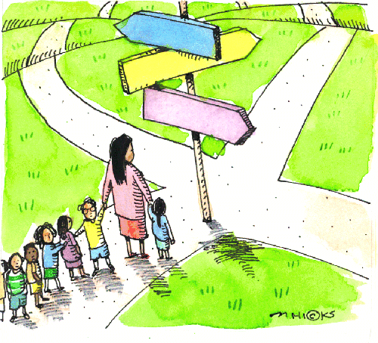
The Promise of Learning Progressions for Determining Pathways for Student Success
Jennifer L. Kobrin, Senior Research Scientist
Center for College & Career Success
Research & Innovation Network
Pearson
NERA Webinar
June 18, 2014

Slide 3
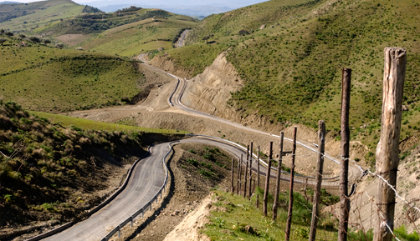
Center for College & Career Success Mission

Slide 4
Webinar Survey Responses on Knowledge of Learning Progressions

Slide 5
Frequently Asked Questions About Learning Progressions
What are learning progressions and how do they relate to standards?
How do learning progressions impact assessment?
How can learning progressions be used to improve teaching and learning?

Slide 6
Today’s webinar
What are learning progressions?
Developing learning progressions
Collecting validity evidence
An example of a learning progression
Use for assessment and instructional feedback
Challenges and future research directions

Slide 7
What are learning progressions?
Also called learning trajectories, progress maps or progress variables
Most common definition (National Research Council, 2007, p. 214):
Descriptions of the successively more sophisticated ways of thinking about a topic that can follow one another as children learn about and investigate a topic over a broad span of time.

Slide 8
A Few Details in the Definition
Qualitatively different ways of thinking about a topic, in contrast to a dichotomous (right/wrong) view.
Focus not only on correct ideas, but misconceptions.
Not developmentally inevitable, but depend on instruction.

Slide 9
Battista (2011)
Standards
Hypothetical Learning Progression or Trajectory
A student’s deviation from the path. This student needs hand- and foot-holds to continue to climb.

Slide 10
Standards
Learning progressions
Aspirational
Discrete objectives
Tied to specific ages or grades
Developed based on conventional wisdom & expert consensus
Hypotheses about how learning develops
Clear connections between learning targets
Assume that students within a grade are at a range of levels
Developed (or informed) from research

Slide 11
Why are we interested in learning progressions?
They can offer a stronger basis for describing the interim goals that students should meet if they are to reach the Common Core standards (CPRE, 2011).
They can be used to guide development of assessments and instructional materials that can provide teachers with a clear map for how student knowledge and skills can develop.

Slide 12
How are learning progressions developed and what do they look like?

Slide 13
How are learning progressions developed?
Top-down: Curriculum experts and teachers develop LP based on their experience teaching children
Bottom-up: Experts construct LP based on learning science research
Source: Heritage (2008)

Slide 14
What do Learning Progressions Look Like?
Levels of Achievement | Progress Variables
5 Upper Anchor | Learning Performances
4
3
2
1 Lower Anchor
Messy Middle
Source: Anderson (2008)

Slide 15
Example: A learning progression on earth and the solar system

Slide 16
Learning Progression on Earth and the Solar System: LEVEL 1
Student does not recognize the systematic nature of the appearance of objects in the sky.
Students may not recognize that the Earth is spherical
COMMON ERRORS:
It gets dark at night because something covers the sun.
The phases of the moon are caused by clouds covering the moon.
The sun goes below the earth at night.
Source: Briggs, Alonzo, Schwab, & Wilson, M. (2006).

Slide 17
Learning Progression on Earth and the Solar System: LEVEL 2
Student recognizes that:
The sun appears to move across the sky every day
The observable shape of the moon changes every 28 days
COMMON ERRORS:
All motion in the sky is due to the Earth spinning on its axis
The sun travels around the Earth
It gets dark at night because the sun goes around the Earth once a day
The Earth is the center of the universe

Slide 18
Learning Progression on Earth and the Solar System: LEVEL 3
Student knows that:
The Earth orbits the sun
The moon orbits the Earth
The Earth rotates on its axis
COMMON ERRORS:
Student has not put this knowledge together with an understanding of apparent motion to form explanations and may not recognize that the Earth is rotating and orbiting simultaneously
It gets dark at night because the Earth goes around the sun once a day.

Slide 19
Learning Progression on Earth and the Solar System: LEVEL 4
Student is able to coordinate apparent and actual motion of objects in the sky, and knows that:
The Earth both orbits the sun and rotates on its axis
The Earth orbits the sun once per year
The Earth rotates on its axis once per day, causing day/night cycle
The moon orbits the Earth once every 28 days, producing phases of the moon
COMMON ERRORS:
Seasons are caused by the changing distance between the Earth and sun
The phases of the moon are caused by a shadow of the planets, the sun, or Earth falling on the moon.

Slide 20
Learning Progression on Earth and the Solar System: LEVEL 5
Student is able to put the motions of the Earth and the moon into a complete description of motion in the solar system which explains:
The day/night cycle
The phases of the moon (including illumination by the sun)
The seasons

Slide 21
Collecting Validity evidence for learning progressions

Slide 22
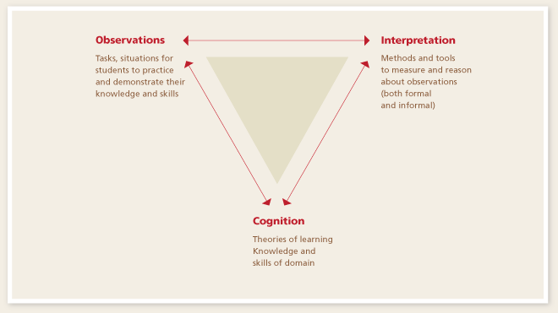
Collecting Validity Evidence for Learning Progressions
Does the learning progression describe how actual students learn?
National Research Council’s (2001) assessment triangle:

Slide 23
Assessments Linked to Learning progressions

Slide 24
Current Assessments Vs. Those Based on a Learning Progression
Current Large-Scale Assessments
Make claims about whether students have reached benchmarks or mastered concepts
Assessments Based on Learning Progressions
Make claims about the sophistication of student knowledge

Slide 25
Assessments Linked to Learning Progressions
Selected Response
Ordered multiple-choice
Choose-explain
Multiple true-false
Constructed Response
Essay
Short-answer
“Next Generation” Assessments
Games
Performance assessments

Slide 26
Use of learning progressions for instructional feedback

Slide 27
“Instructionally Actionable” assessment (Furtak, Morrison, & Iverson, 2013)
Supports teachers in making inferences about what students know
Provides information in a timely manner
Designed to elicit specific information about what students know

Slide 28
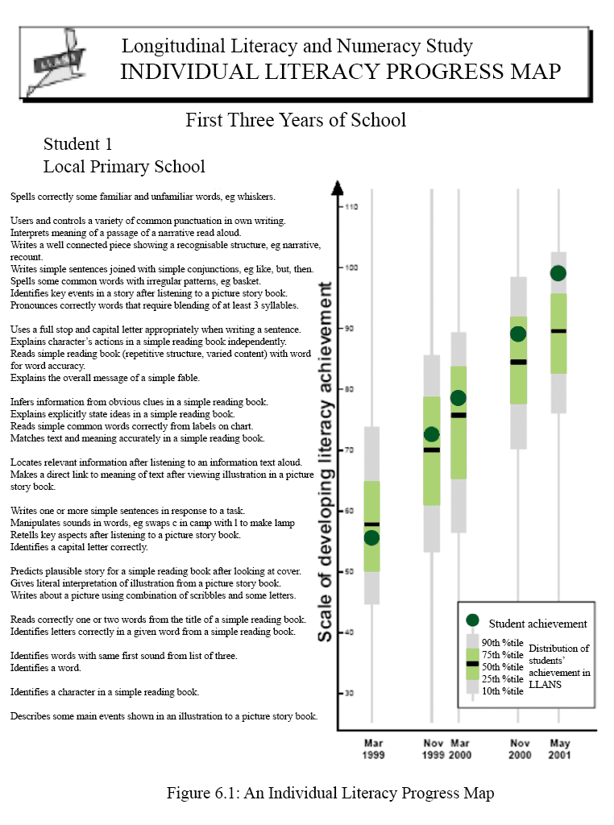
Australia’s Individual Literacy Progress Map
Source: Meiers, et al. (2006)

Slide 29
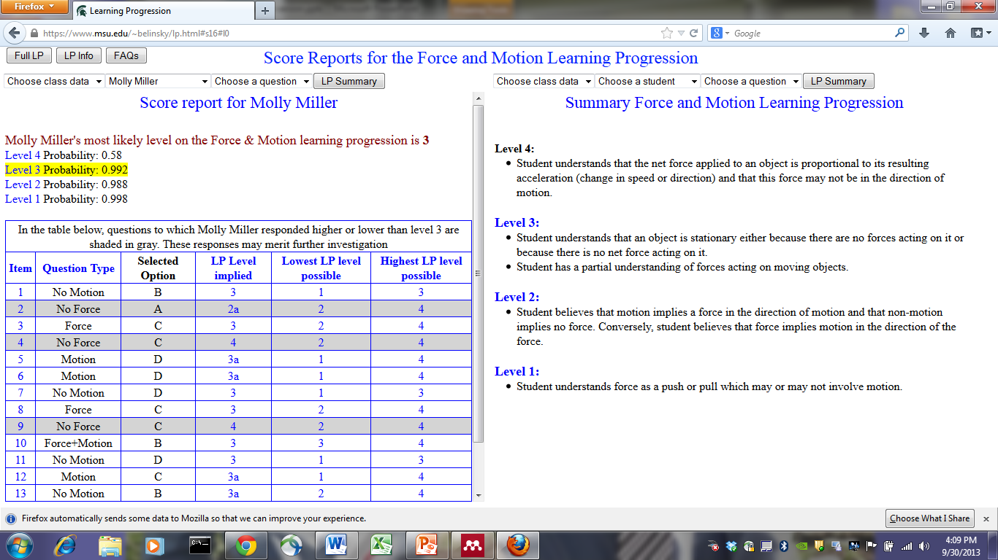
Force and Motion Learning Progression Online Score Report (Alonzo et al., 2014)

Slide 30
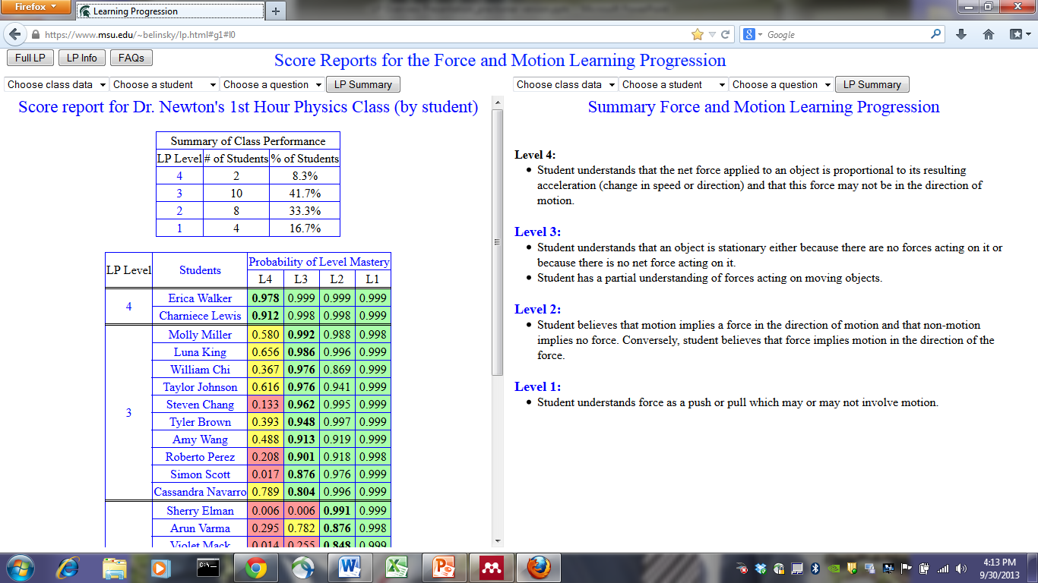

Slide 31
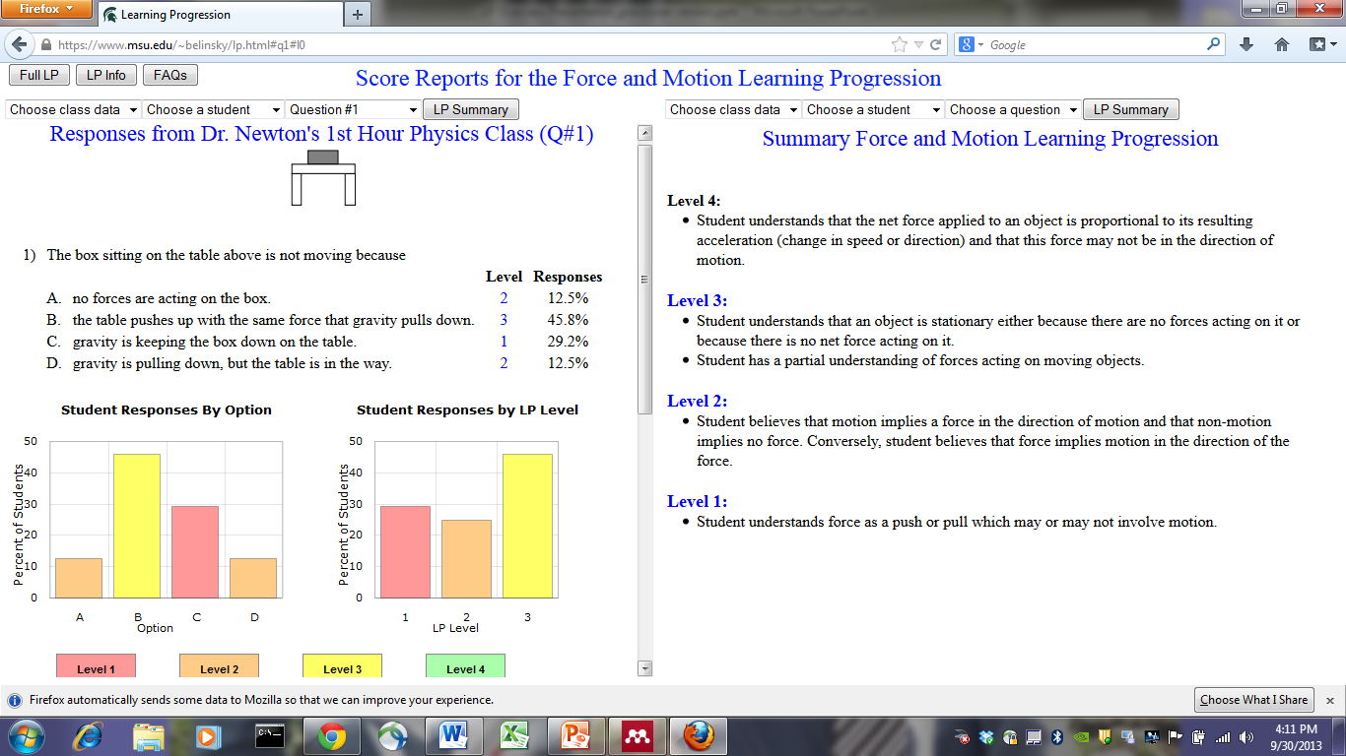

Slide 32
Challenges Presented by Learning Progressions
Multiple pathways to learning
Lack of consistency in student responses
Determining grain size
Multidimensionality
Limited number of research-based learning progressions

Slide 33
Future research

Slide 34
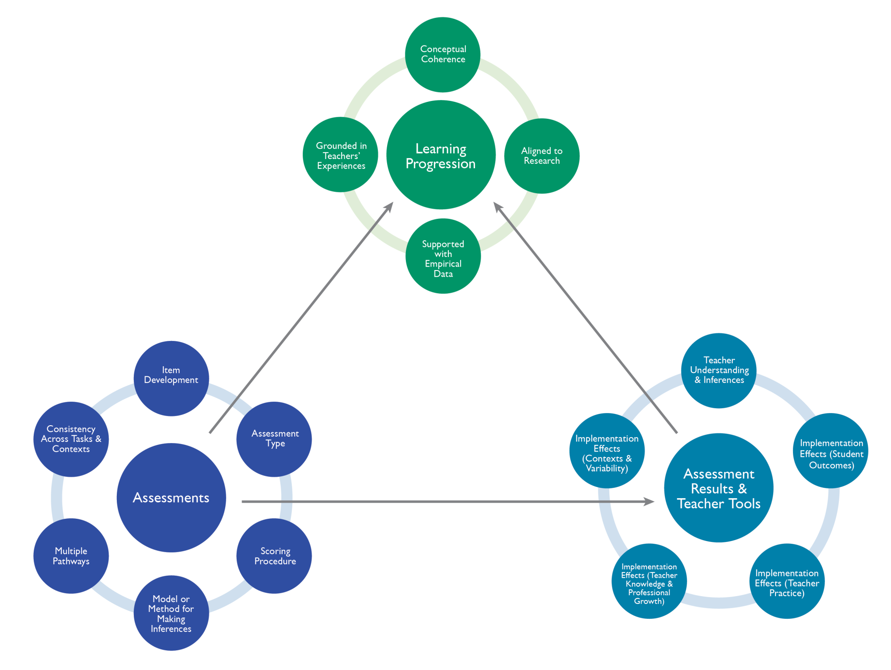

Slide 38
References
Alonzo, A.C., de los Santos, E.X., & Kobrin, J.L. (2014). Teachers’ interpretations of score reports based upon ordered-multiple choice items linked to a learning progression. Paper presented at the annual meeting of the American Educational Research Association (Philadelphia, PA, April 7, 2014).
Anderson, C.W. (2008). Conceptual and empirical validation of learning progressions. Response to “Learning Progressions: Supporting Instruction and Formative Assesment” (unpublished paper, available from http://edr1.educ.msu.edu/EnvironmentalLit/index.htm).
Battista, M. T. (2011). Conceptualizations and issues related to learning progressions, learning trajectories, and levels of sophistication. Montana Mathematics Enthusiast, 8(3), 507-569.
Briggs, D.C., Alonzo, A.C., Schwab, C., & Wilson, M. (2006). Diagnostic assessment with ordered multiple-choice items. Educational Assessment, 11, 33-63.
Consortium for Policy Research in Education (2011). Learning trajectories in mathematics: A foundation for standards, curriculum, assessment, and instruction. (CPRE Research Report #RR-68).
Furtak, E.M., Morrison, D., & Iverson, H. (2013). Challenges in developing classroom assessments linked to multidimensional learning progressions. Paper presented at the National Association of Research on Science Teaching Annual International Conference, Puerto Rico, April 2013.
Heritage, M. (2008). Learning progressions: Supporting instruction and formative assessment. Paper prepared for the Formative Assessment for Teachers and Students (FAST) State Collaborative on Assessment and Student Standards (SCASS) of the Council of Chief State School Officers (CCSSO).
Meiers, M., Khoo, S.T., Rowe, K., Stephanou, A., Anderson, P., & Nolan, K. (2006). Growth in literacy and numeracy in the first three years of school. Australian Council for Educational Research (ACER Research Mongraph 6-1-2006). Available from: http://research.acer.edu.au/acer_monographs/1.
National Research Council [NRC] (2001). Knowing what students know: The science and design of educational assessment. (Pelligrino, J., Chudowsky, N., and Glaser, R., Eds). Committee on the Foundations of Assessment, Board on Testing and Assessment, Center for Education. Division of Behavioral and Social Sciences and Education. Washington, DC: National Academy Press.
National Research Council [NRC] (2007). Taking science to school: Learning and teaching science in grades K-8. Washington, CD: The National Academies Press.

Slide 39
Questions? Comments?
Jennifer.kobrin@pearson.com

