Slide 1
Delivering an Academic Presentation
Joseph Rios, PhD
Center for Measurement Justice & Grad Student Academy

Slide 2
Objectives
Tackling presentation nerves
Preparing a presentation
Delivering a presentation

Slide 3
Tackling Presentation Nerves

Slide 4
Why Academic Presentations Matter?
Dissemination of knowledge
Receiving feedback
Developing communication skills
Building reputation

Slide 5
Presenting Research Is A Skill
Academic presentations involve:
Public speaking
Content organization
Visual communication
Audience engagement
Ability to handle questions

Slide 6
Emotional Barriers To Improving Presentation Skills
Fear of public speaking
Imposter syndrome
Perfectionism
Lack of confidence

Slide 7
Preparing Your Presentation

Slide 8
Things To Consider Before Preparing Your Presentation
Objectives
Audience
Time Constraints
Venue and Technology

Slide 9
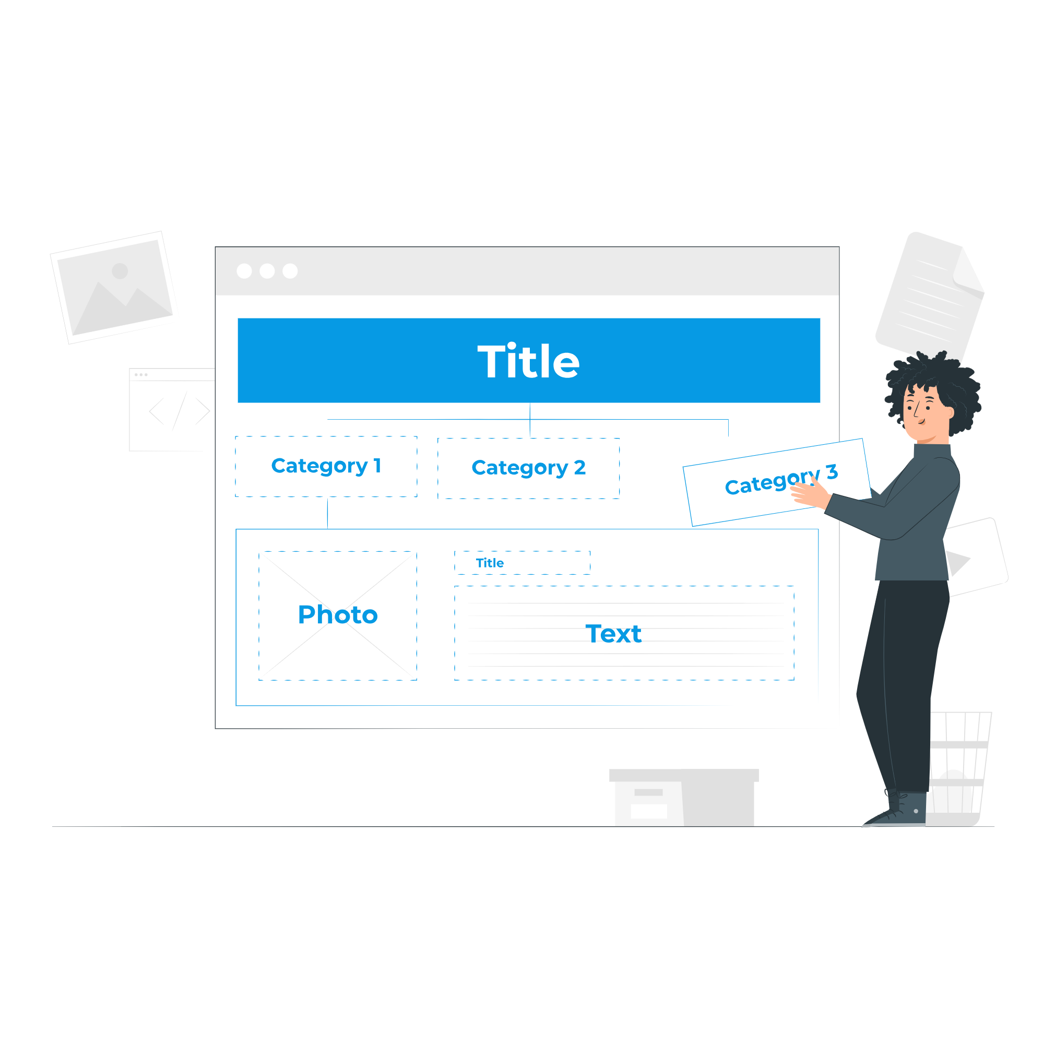
Structuring Your Presentation
Introducing yourself
Background
Method
Results
Discussion
Contact information

Slide 10
Introducing Yourself
"Good morning/afternoon/evening everyone. My name is [Your Name], and I'm a [Your Position] at [Your Affiliation]. Today, I'll be presenting my research on [Research Topic].
In this presentation, I'll discuss [Main points of your presentation]. My goal is to [State the objective of your presentation].
I'm excited to share my findings with you and look forward to your questions."

Slide 11
Background
Problem statement
Gaps in the field’s knowledge
Study objective(s)
Research question(s)

Slide 12
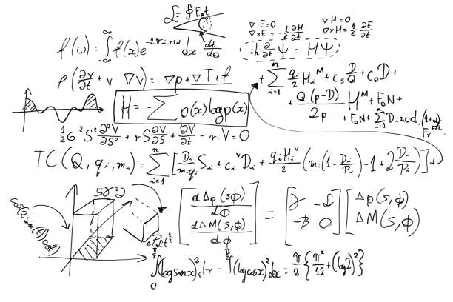
Method
Design
Participants
Data collection
Analysis techniques
Ethical considerations

Slide 13
Results
Focus on two to three major findings
Describe your results as a story not a list of analyses
Organize your description of results around actors and their actions
Methodologically-oriented:
“There was a main effect for mentoring type on first-year PhD student retention.”
Condition-oriented:
“First-year PhD retention was greater in the mentoring condition than the control condition.”
Actor-oriented:
“PhD students had higher retention when they received intensive mentoring than when they did not.”

Slide 14
Are Visual Elements Needed?
Questions to ask:
Could this information be summarized easily in text?
Is the information important to your story?
Does the visual element require too much explanation to be comprehended?

Slide 15
Figures Versus Tables: When To Use Each
When Is Each Preferable?
Figures | Tables
Conveying percentages | Precise numerical values
Trends over time | Listing categorical information
Spatial data | Complex data with multiple variables
Comparisons and contrasts

Slide 16
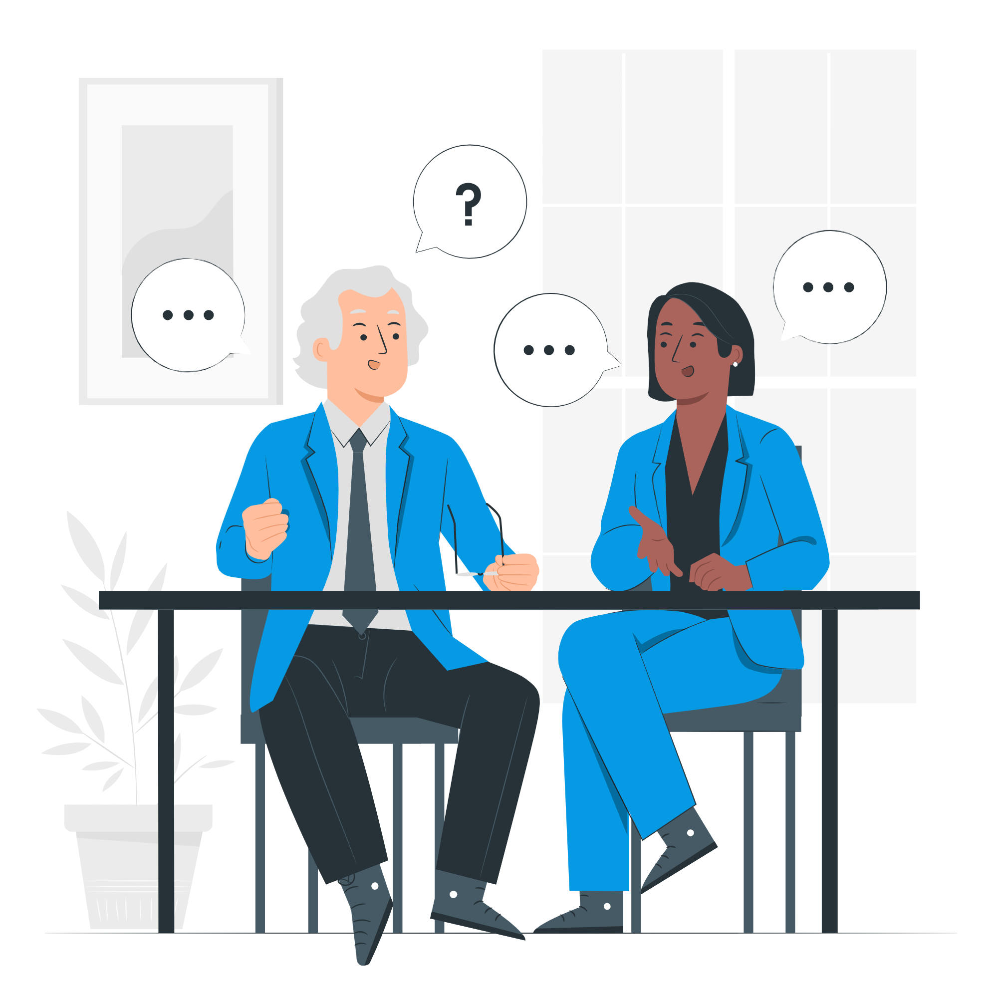
Discussion
The discussion provides you an opportunity to describe:
How the findings are related to prior literature
Reasons for not overgeneralizing your findings
Suggestions for future research
Why your results are important

Slide 17
Contact Information
Expressing gratitude shows appreciation for the audience's time and attention
Contact information to include:
Email address
Socials
Website URL

Slide 18
Tips For A Visually Appealing Slide Deck
Avoid overloading slides
Choose a consistent design
Use fonts wisely

Slide 19
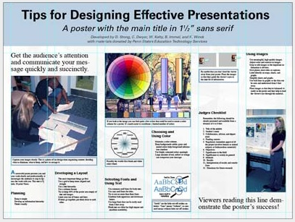
Tips For A Poster Presentation
Title is short and engaging
Word count is minimal
Use of headlines to guide reader’s attention
Consistent and clean layout
Image credit: Poster Session Tips by mousejockey@psu.edu

Slide 20
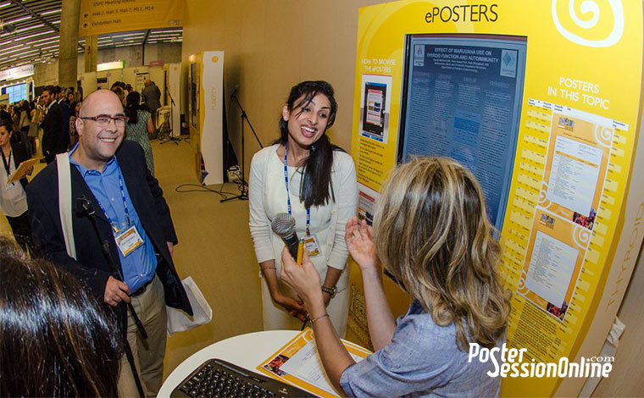
Tips For An Electronic Poster
Its biggest advantage is interactivity
Encourage engagement via multimedia elements
Account for rolling nature of slide deck

Slide 21
Delivering Your Presentation

Slide 22
Practice, Practice, Practice
Practice out loud
Time yourself
Seek feedback
Address areas for improvement

Slide 23
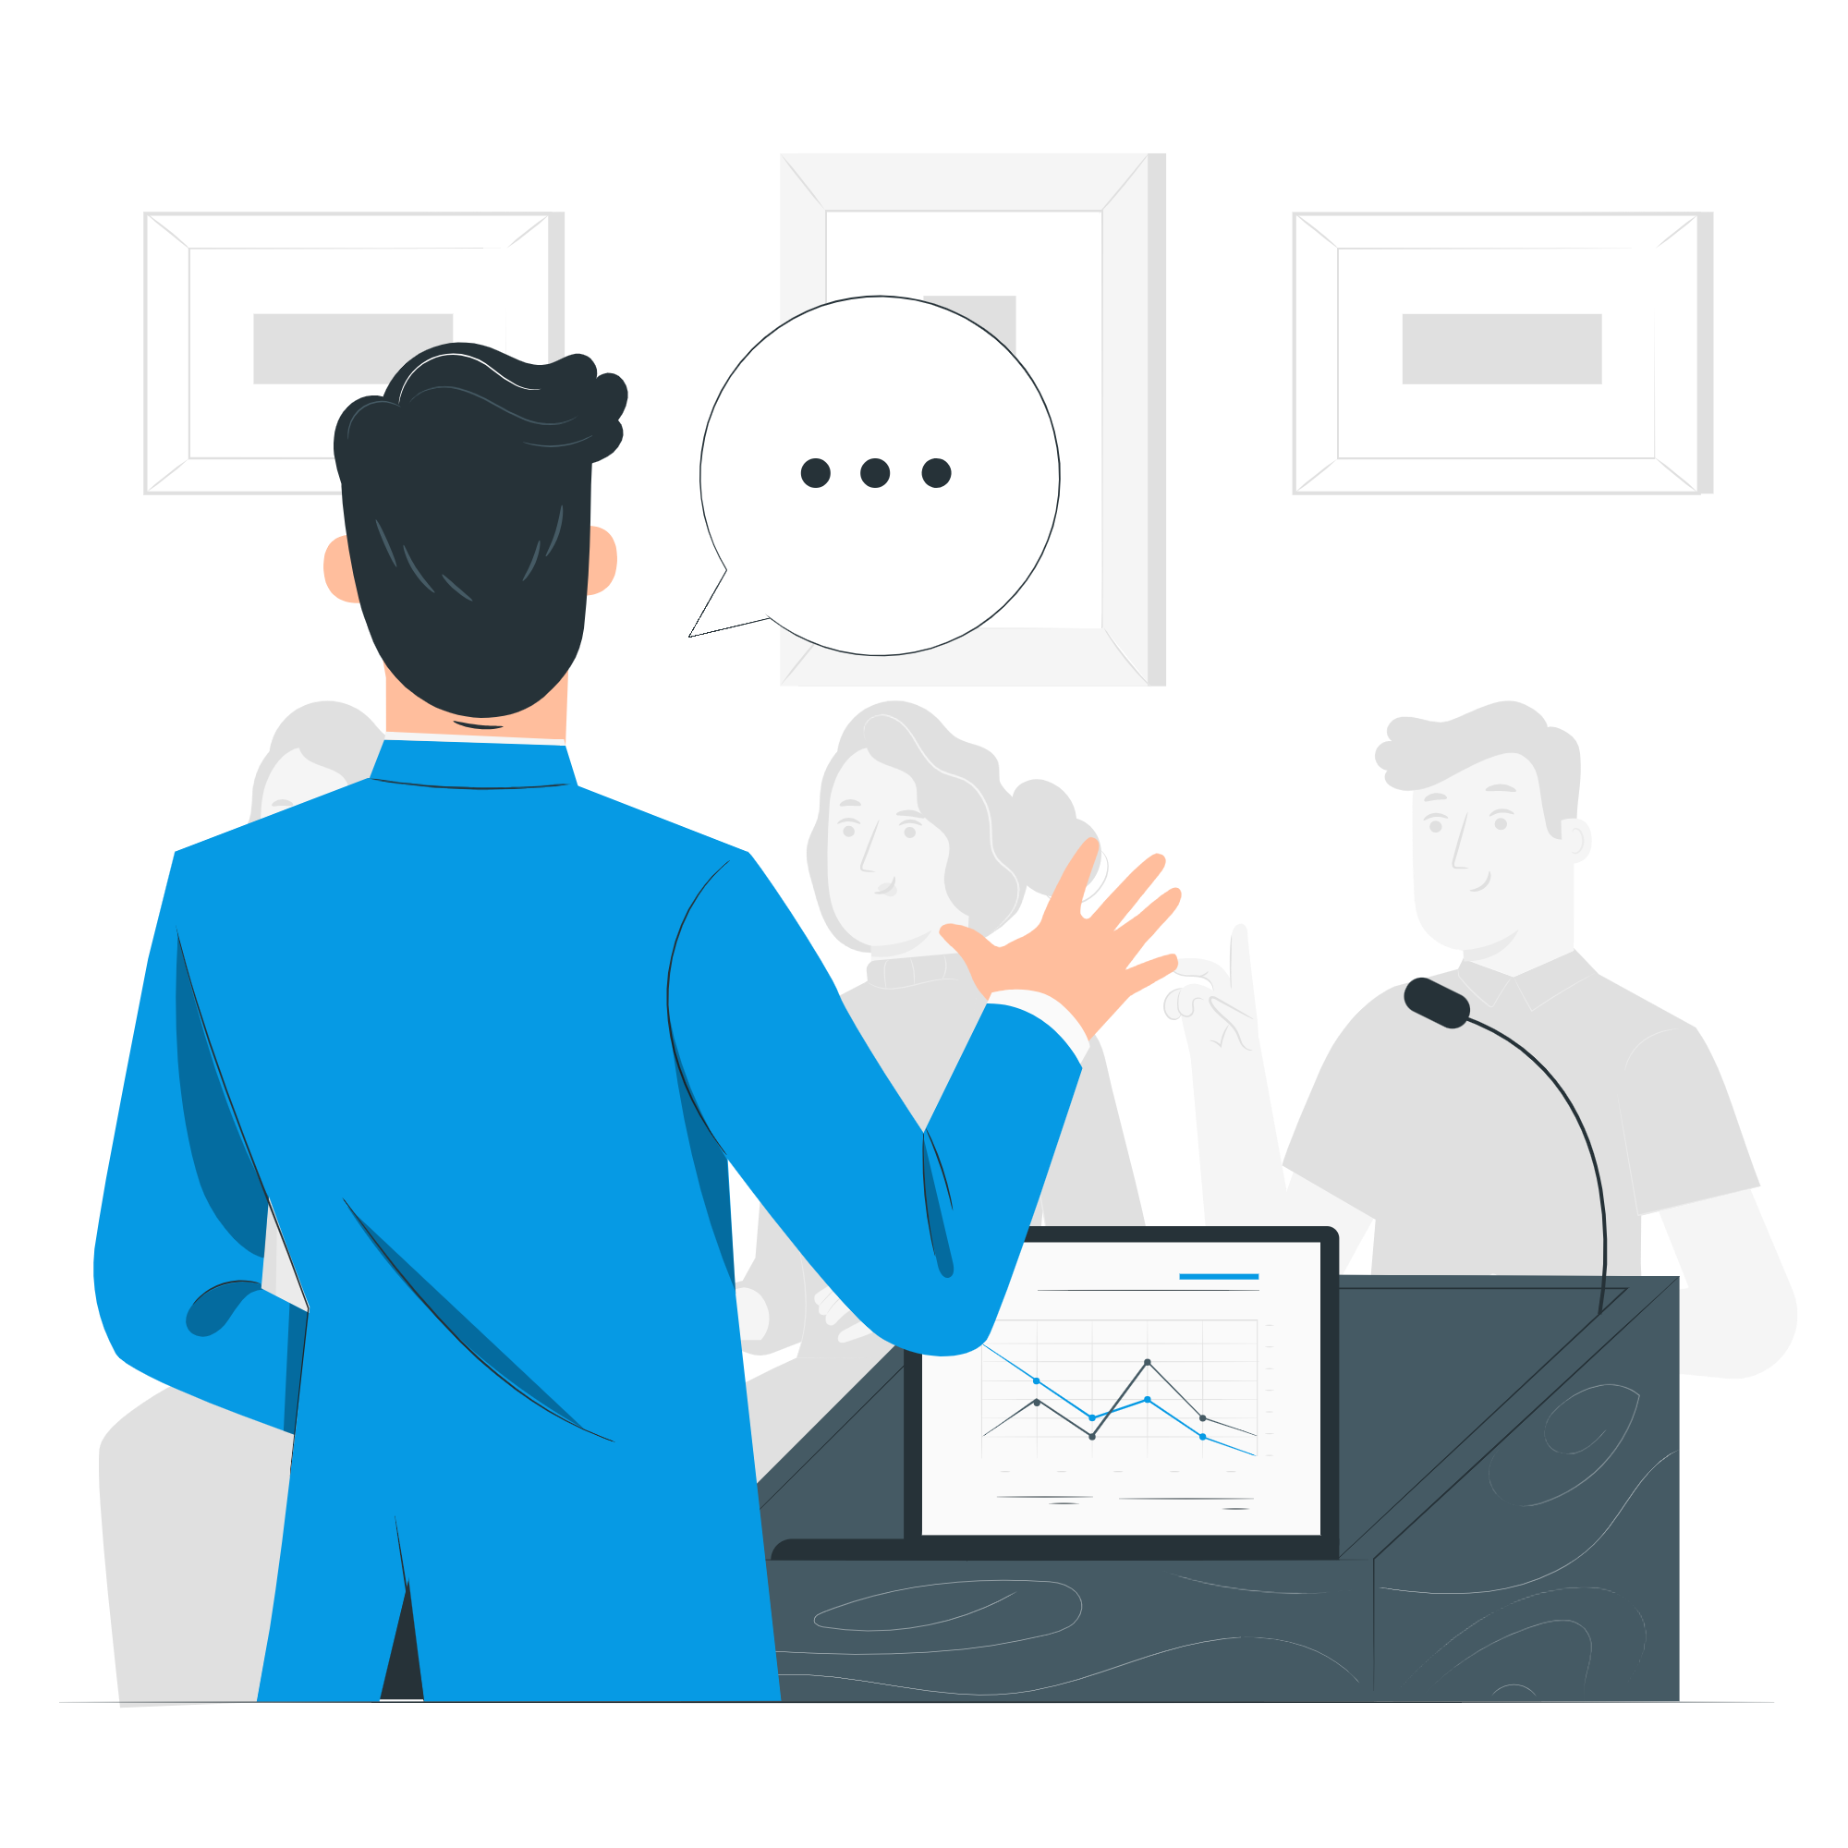
Body Language and Voice
Maintain audience eye contact
Use open body language
Vary tone
Pause for emphasis
Avoid filler words

Slide 24
Handling Questions
Anticipate questions
Listen attentively
Provide direct responses
Admit when you don’t know the answer
Thank the audience for their questions

Slide 25
Conclusion

Slide 26
Summary
It’s okay to feel nervous, that’s normal
Presenting is a skill that you can improve
Focus on being a good storyteller
Use visuals as an aid to your speech
Keep practicing, you got this

Slide 27
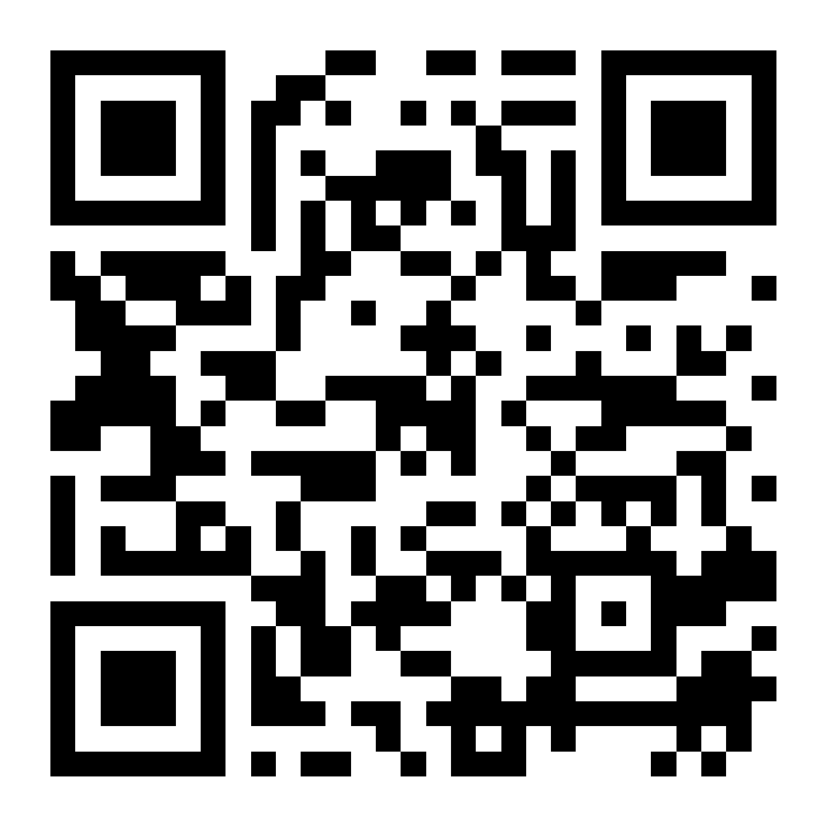
Thank You!
Joseph Rios, PhD
jrios@gradstudentacademy.org

